Slide 1
WGHS NCEA Scholarship information evening
Wednesday 26th February – 6.30pm

Slide 2
What is scholarship?
Extensive examinations designed for students to sit in their senior years
Both written examinations and portfolio submission
The top 3% of all candidates in each subject are awarded a Scholarship
The top 0.3% of all candidates in each subject are awarded an Outstanding Scholarship
Students can earn prize money per subject to put toward their New Zealand tertiary education

Slide 3
Scholarship prize money

Slide 4
Why enter scholarship?
This provides our most academically capable students with even more extension in their school subjects.
This is the highest academic qualification for NCEA.
Prize money which can be used towards tertiary education in New Zealand.
Advantage of having this higher qualification when applying for jobs, university scholarships, competitive courses, halls of residence etc
Multiyear level – start studying in Year 11 or 12.

Slide 5
WGHS Scholarship programme
Extramural Scholarship classes for Year 12 and 13.
Extramural Scholarship classes are taught either before school (usually 7.30am start) or after school (usually 4.30pm finish) or during lunchtimes.
Students will have access to mentor throughout the year to help students stay on track to achieving their scholarship paper.
Events throughout the year from assemblies to potential workshops (TBC).
Scholars assembly the following year to recognise your achievement.

Slide 6
Year 11
Year 11 students are welcome to apply and will be admitted on a case-by-case basis. This will be determined by the scholarship teacher + Mr Burton.
The subjects where students are most likely to gain entry are History, Geography, Psychology, English, and PE & Health.
Some students may choose to attend the tutorials to gain experience but not sit the exam. This is absolutely fine.

Slide 7
What you need to put in
Attendance at tutorials – if there are an clashes see Mr Burton.
Good organisation – study plan.
Communication with your teachers, past scholarship students and mentor.
Spread out your study across the whole year – not cramming in the last term.
Ask your scholarship teachers for extra resources that are on offer.

Slide 8
What subjects are on offer
Accounting
Art History
Biology
Calculus
Chemistry
Chinese
Classical Studies
Drama
Earth and Space Science
Economics
English
French
Geography
History
Japanese
Music
Psychology - new this year
Spanish
Te Reo Maori
Year 13 Only:
Design
DVC
Painting
Photography
Sculpture
Technology

Slide 9
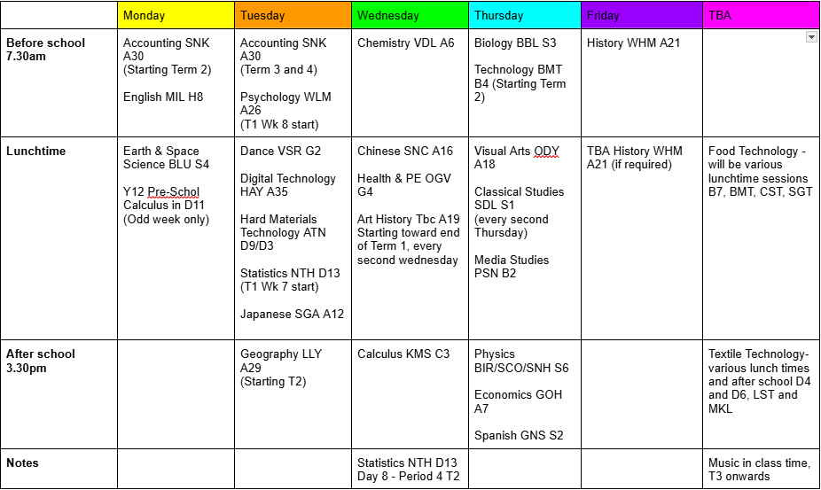
Extramural Tutorial Timetable

Slide 10
Elaine Zhou and Julia Wilkins

Slide 11
Why should you sit NCEA Scholarship?
Don’t need to be an excellence student
Knowledge and experience
Different way of thinking
Money

Slide 12
Scholarships 101
Notes:
You don’t have to be taking a subject to sit the scholarship

Slide 13
Essay based | Languages/ culture
Agriculture and Horticulture Art History Classical Studies English Geography History Media Studies Psychology Religious Studies | Chinese French German Japanese Latin Samoan Spanish Te Ao Haka Te Reo Maori Te Reo Rangatira
Portfolio (excl. drama) | Sciences/ maths/ business
Health and PE Dance DVC Digital Tech Music Technology Visual Arts Drama | Accounting Biology Calculus Chemistry Earth and Space Science Economics Physics Statistics
Exam based
Portfolio
Total: 35

Slide 14
What do I love?
What am I good at?
How difficult is the scholarship?
How much time will study take?

Slide 15
LEVEL 2
Essay based | Languages/ culture
Agriculture and Horticulture Art History Classical Studies English Geography History Media Studies Psychology Religious Studies | Chinese French German Japanese Latin Samoan Spanish Te Ao Haka Te Reo Maori Te Reo Rangatira
Portfolio (excl. drama) | Sciences/ maths/ business
Health and PE Dance DVC Digital Tech Music Technology Visual Arts Drama | Accounting Biology Calculus Chemistry Earth and Space Science Economics Physics Statistics
Key:
Easy to pick up at level 2
If you’re fluent/ have previous experience

Slide 16
LEVEL 3
Essay based | Languages/ culture
Agriculture and Horticulture Art History Classical Studies English Geography History Media Studies Psychology Religious Studies | Chinese French German Japanese Latin Samoan Spanish Te Ao Haka Te Reo Maori Te Reo Rangatira
Portfolio (excl. drama) | Sciences/ maths/ business
Health and PE Dance DVC Digital Tech Music Technology Visual Arts Drama | Accounting Biology Calculus Chemistry Earth and Space Science Economics Physics Statistics
Key:
Classroom subject
Not a ‘school subject’

Slide 17
Year 12
Year 13
English
History
Geography
Health and P.E
Harder:
STEM subjects
Portfolios
Languages (unless fluent)
Literally everything.
Sit scholarships in whatever you like.

Slide 19
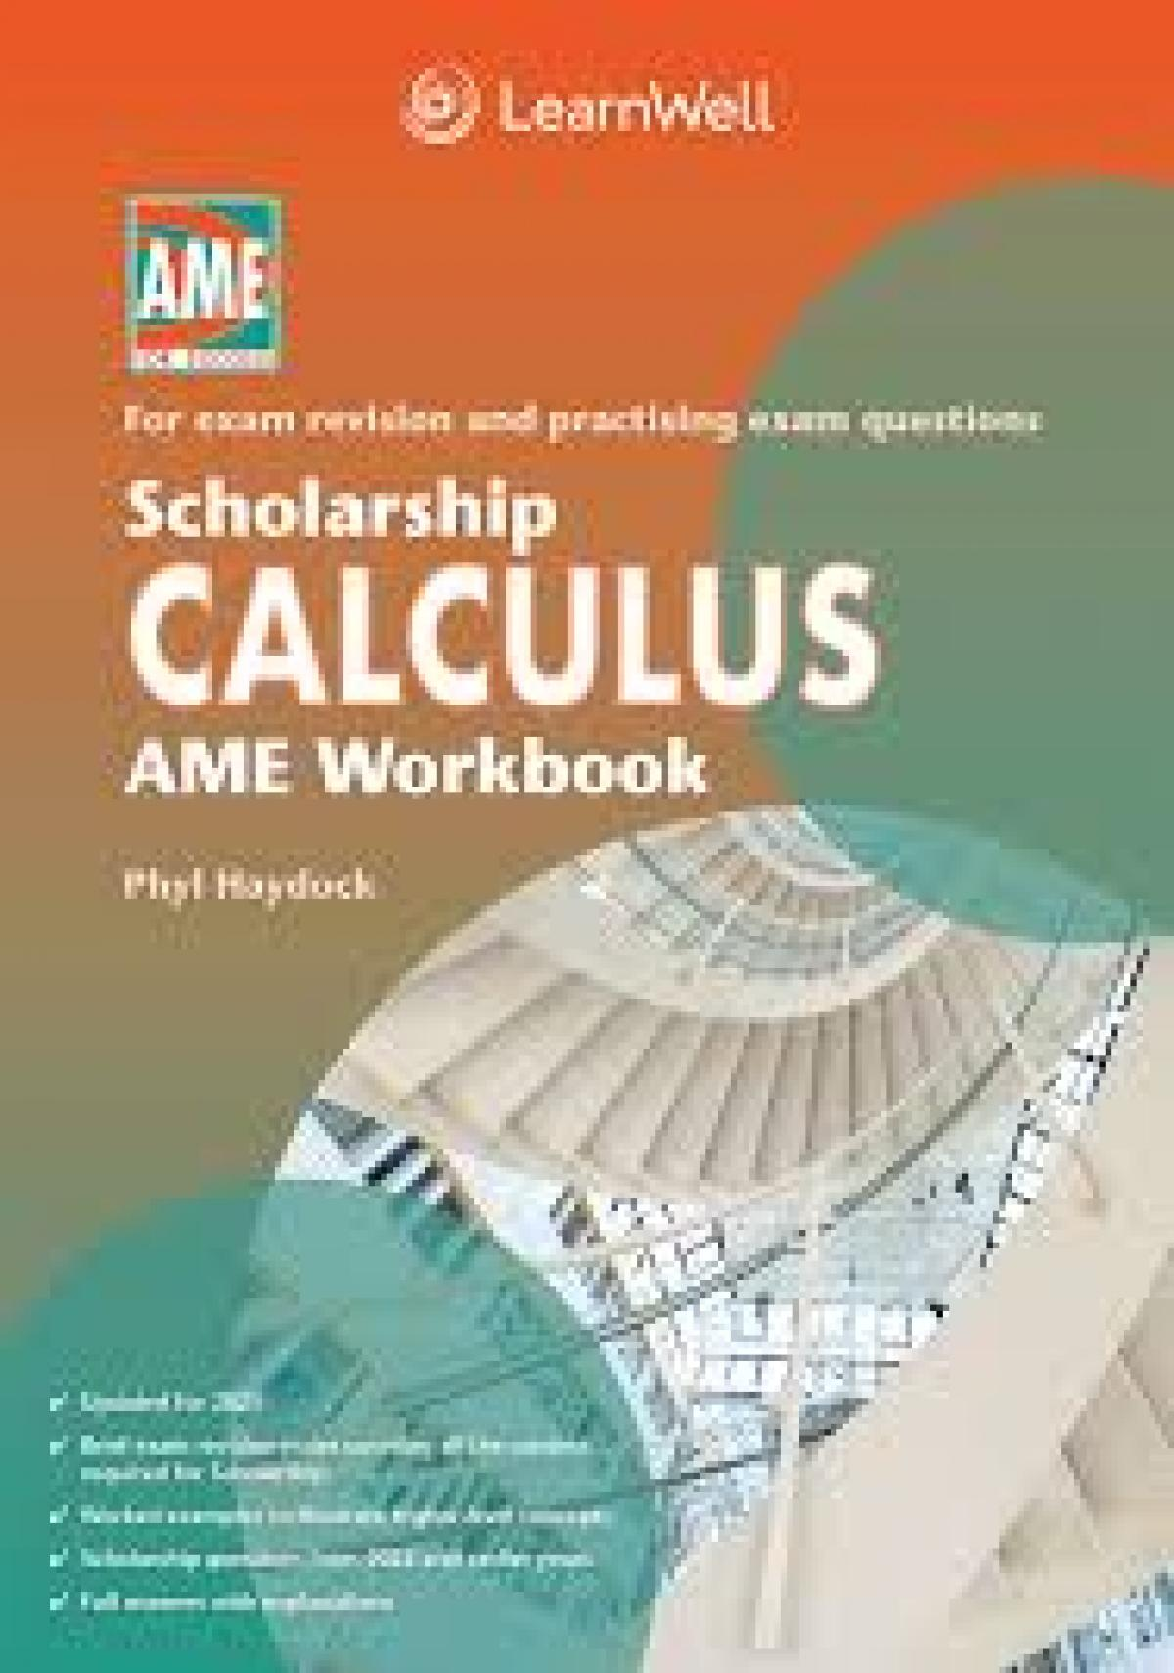
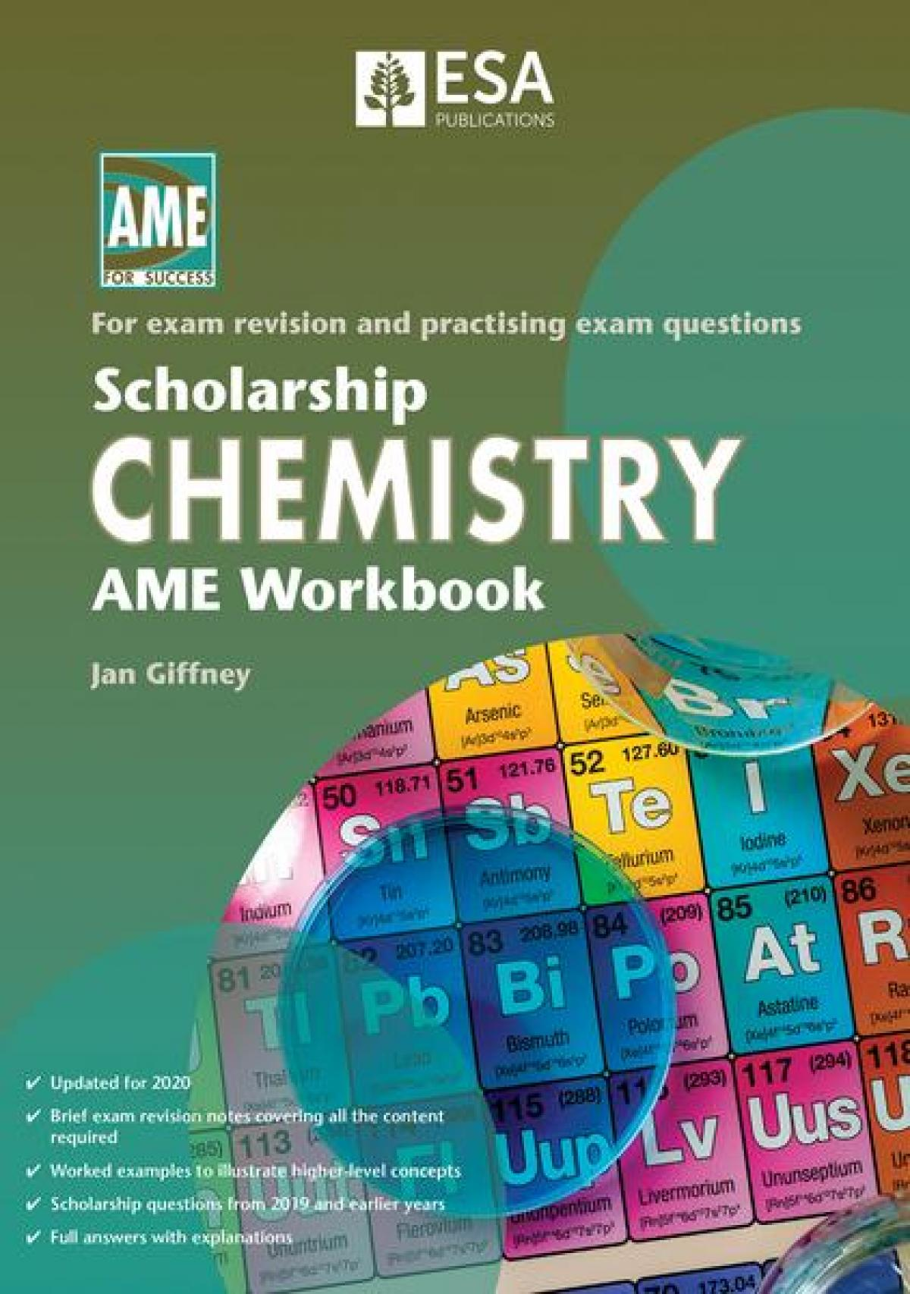
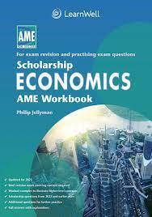
Best Ways to Prepare
Mock Exams
Understanding the exam
Extra material
The tutorials: to go or not to go?
Buy the workbooks
Notes:
Definitely go to mocks exams. Get extra material from library etc. Actually make sure you understand all the questions in the exam- what do you have to do for each part- because some are always structured like this. Tutorials you should definitely go to, but if you can’t make one, then still sit the scholarship anyway!

Slide 20
Study Plans

Slide 21
Good luck!

Slide 22
Scholarship teacher panel

Slide 23
Thank you for coming and please feel free to stick around and ask myself, the students, or the teachers questions.

